Slide 1
SSIS SQL Server Integration Services
Kurt Friedrich
Spring 2015

Slide 2
http://www.mssqltips.com/sqlservertutorial/200/sql-server-integration-services-ssis/
SSIS is a tool that we use to perform ETL operations
extract, transform and load data.
While ETL processing is common in data warehousing (DW) applications, SSIS is by no means limited to just DW
At a high level, SSIS provides the ability to:
retrieve data from just about any source
perform various transformations on the data; e.g. convert from one type to another, convert to uppercase or lowercase, perform calculations, etc.
load data into just about any source
Set up daily, weekly, etc autoruns
Bunch of “tips” at, also gives indication of the power it has:
http://www.mssqltips.com/sql-server-tip-category/17/integration-services-development/

Slide 3
Run SSIS periodically
You can run SSIS periodically, to keep your data warehouse current.
You deploy a SSIS project to the SSIS Catalog and configure it to use environment values.
Create a SQL Agent job which will run this package and assign a schedule to the Job.
This site seems useful, but I didn’t join and explore:
http://www.sqlservercentral.com/stairway/72494/

Slide 4
Import and Export Wizard
SQL Server Management Studio (SSMS) provides Import and Export Wizard tasks which you can use to copy data from one data source to another.
You can choose from a variety of source and destination data source types, select tables to copy or specify your own query to extract data, and save your work as an SSIS package.
Using the Import and Export Wizard is a good starting point for learning about SSIS packages.
But won’t work for us, we will get to SSIS by doing a simple Import into our DB from within SSMS, which will in turn call SSIS

Slide 5
Now on to importing our 450 orders
I pulled the csv file with the top row of field definitions into Excel, and then saved it as an Excel file.
Then I edited the XLS, then saved as a csv
You must have your NodeOrders DB set up, I suggest deleting it, then running my scripts in the correct order

Slide 6
I got the excel doc ready (fixing time format so that it will import)
Open the CSV file with Excel.
Select all the items in the datatime column, then under the data tab, there is a “text to columns” menu choice
Delete the resulting first and end 2 new columns to get rid of the day of the week, GMT time, and Timezone
So a column like this: Mon Apr 13 2015 22:25:45 GMT-0700 (PDT)
Ends up as just 4 columns likie
Apr 13 2015 22:24:45
Now concatenate the 4 back to 1 col, the time column will try to turn into the internal data respresention, so use this supplied function to get it into the correct format. Make a new column using an equation like this, accounting for the differences in wherever your columns ended up
=K2&" "&L2&" "&M2&" "&TEXT(N2,"HH:MM:SS")
Now save the csv file as a CSV file. Then make a copy of it, then open up the copy and get rid of those 4 columns that are now combined into one.
Move that new datetime over next to the other columns
Insert a new first column called OrderID
add values from 1 to 450 (do 1, 2, 3, then select those 3 and drag to botton)
Save this file using SAVE AS an Excel file, then use that excel file for the import within SSMS

Slide 7
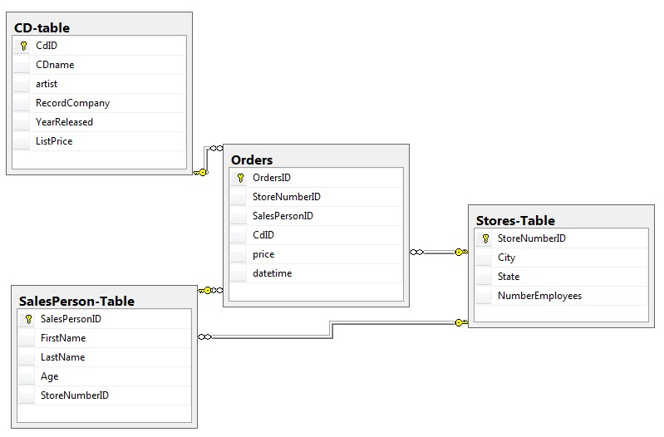
Delete all the DATA values in the 4 tables, but save the tables.
Use my scripts (in Fill-3-Tables.zip) to load our unique data into the 3 “dimensions” tables.

Slide 8
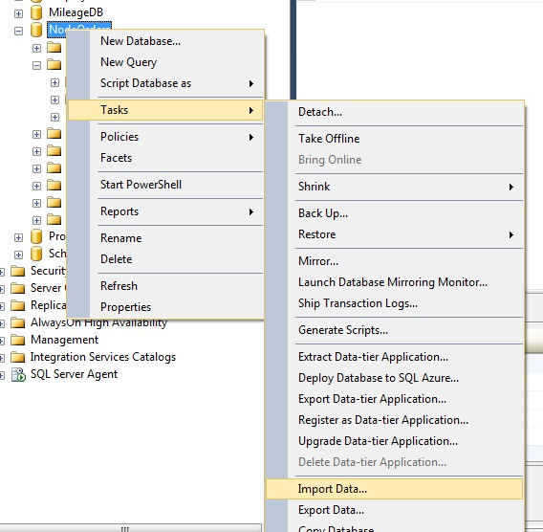

Slide 9
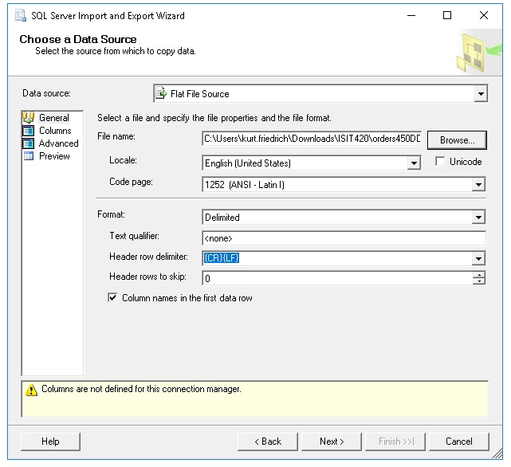

Slide 10
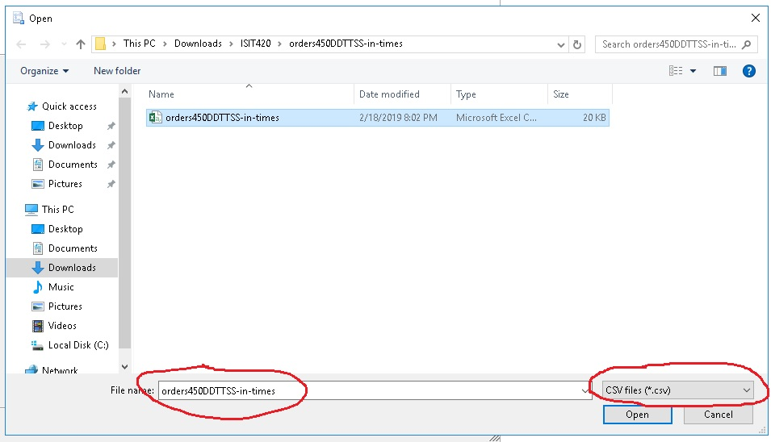

Slide 11
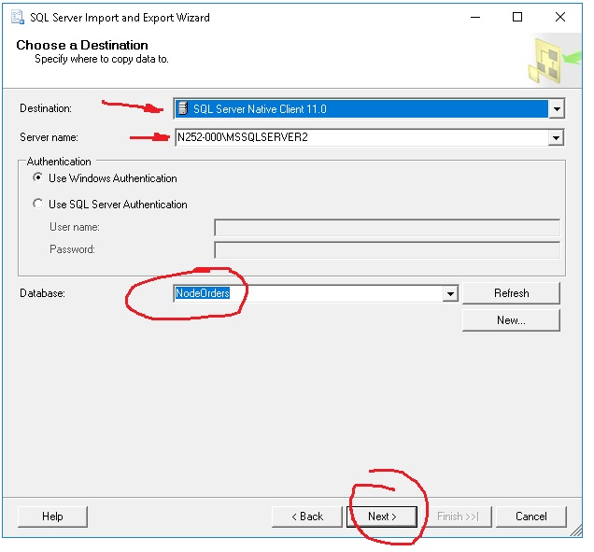

Slide 12
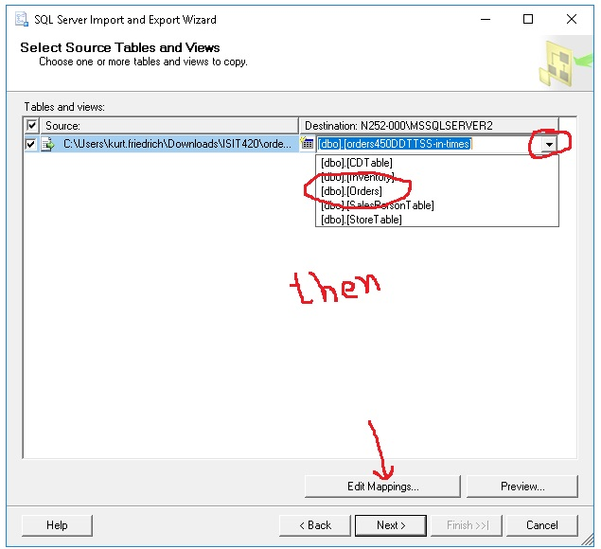

Slide 13
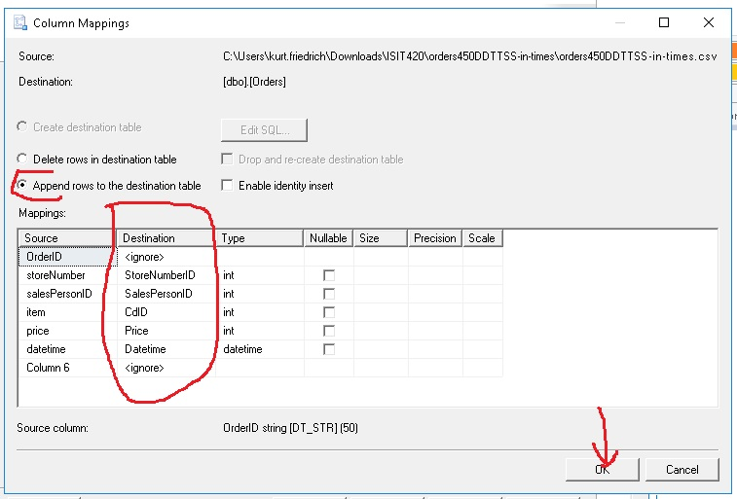

Slide 14
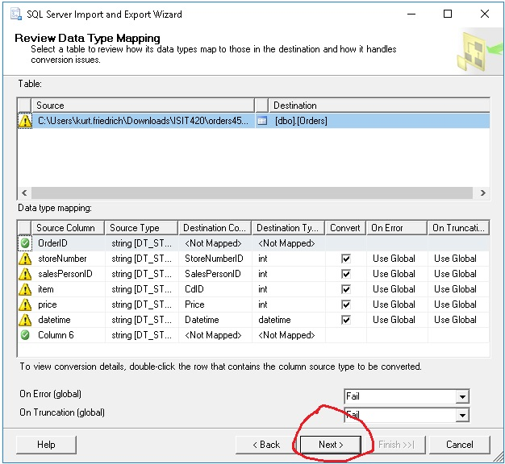

Slide 15
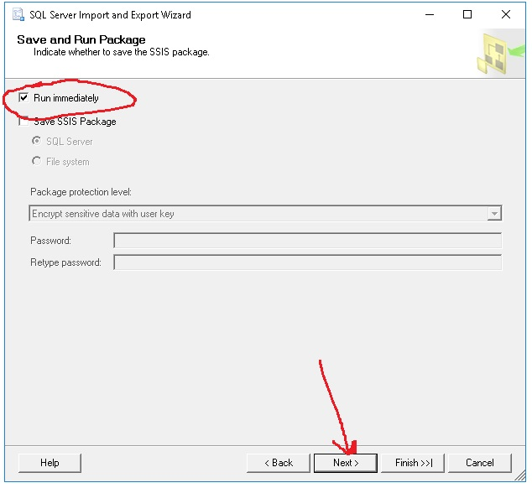

Slide 16
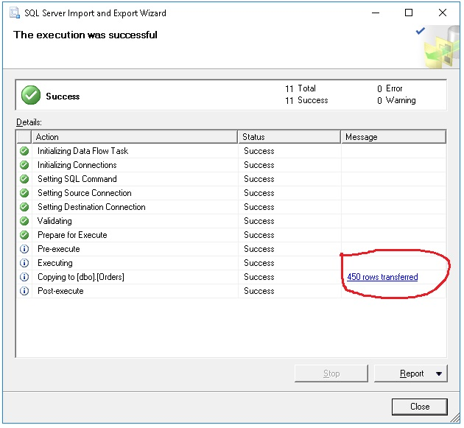

Slide 17
